Slide 1
WELCOME to Deerfield AYSO Region 1007 Coach Orientation
Regional Commissioner
Stuart Slutzky
RC1007@DeerfieldAYSO.org

Slide 2
AYSO Philosophies
OPEN REGISTRATION
EVERYONE PLAYS
BALANCED TEAMS
POSITIVE COACHING
GOOD SPORTSMANSHIP
PLAYER DEVELOPMENT

Slide 3
Board Of Directors Contact email on web site http://www.deerfieldayso.org/
Key Regional Board Contacts
Board Position | Contact
Commissioner | Stuart Slutzky
Registrar | Eric Meyers
Assistant Registrar | Mike White VanGompel
Coach Administrator | Brad Sloan
Referee Administrator | Tomer Amram
Safety Director | Drew Serlin
Child & Volunteer Protection Advocate | Drew Serlin
Equipment Director | Steve Harfield
EXTRA Play Coordinator | Bobby Cooper
Director of Fields | Daniel Moons

Slide 4
Board Of Directors Contact email on web site http://www.deerfieldayso.org/
Key Regional Board Contacts
Board Position | Contact
Playground Division Manager | Daniel Moons
5U Division Manager | Eric Meyers
6U Division Manager | Brad Zabel
8U Division Manager | Mike Collins
10U Division Manager | Brad Sloan
12U/14U Division Manager | Ron Schwartz
Secretary | Jen Penzenik
Technology & Social Media Director | Jen Penzenik
Treasurer | Steven Hamilton

Slide 5
Important Dates
First Game – September 12th
Picture Day – September 26th (Maplewood)
Last Game – November 7th

Slide 6
Division Guidelines
Division | Duration | Players on Field | Ball size
5U/6U (Pre-K & K) | 2x15 minute halves Quick substitution at midpoint of each half 5 minute halftime | 3v3 (no goal keeper) | 3
8U (1st & 2nd graders) | 2x20 minute halves Quick substitution at midpoint of each half 5 minute halftime | 5v5 (no goal keeper) | 3
10U (3rd & 4th graders) | 2x25 minute halves Quick substitution at midpoint of each half 5 minute halftime | 7v7 | 4
12U (5th & 6th Graders) | 2x30 minute halves Quick substitution at midpoint of each half 5 minute halftime | 9v9 | 4
14U (7th & 8th Graders) | 2x35 minute halves Quick substitution at midpoint of each half 5 minute halftime | 11v11 | 5

Slide 7
Player Training
Weekly professional training (optional)
August 30th thru November 5th
No training on 9/6, 9/7 and 9/16
Training held at Wilmot school thru 10/1
Training held at Jewett beginning 10/4
 | Monday | Tuesday | Wednesday | Thursday | Friday
4:30pm - 5:30pm | 5U/6U | 10U/12U | 8U | 8U/10U/12U | 5U/6U
5:30pm - 7:00pm | EXTRA Program Clinics |  |  |  | 14U

Slide 8
Sideline Rule
Coaches and players encouraged to, but not required to, sit on opposite sideline of spectators for 5U and 6U
Coaches and players MUST sit on opposite sideline of spectators for 8U and above

Slide 9
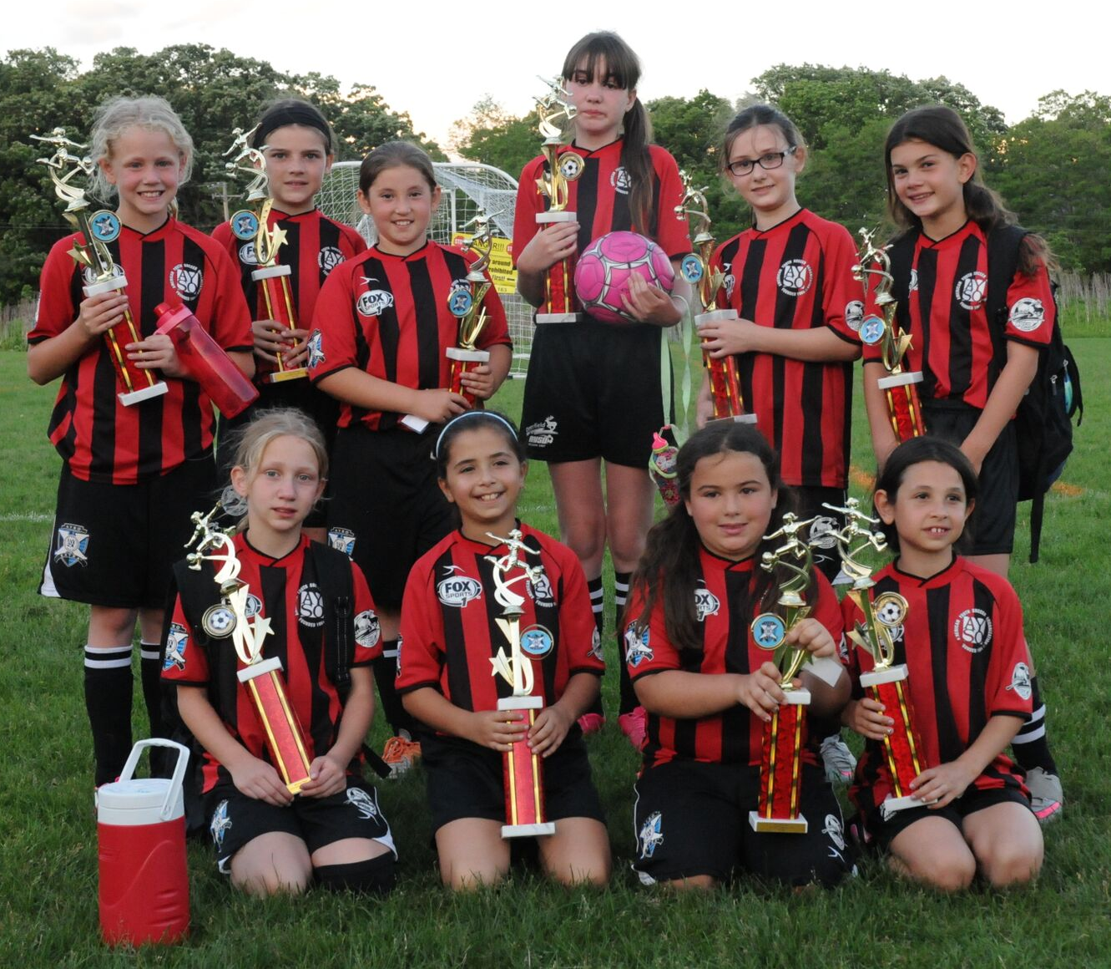
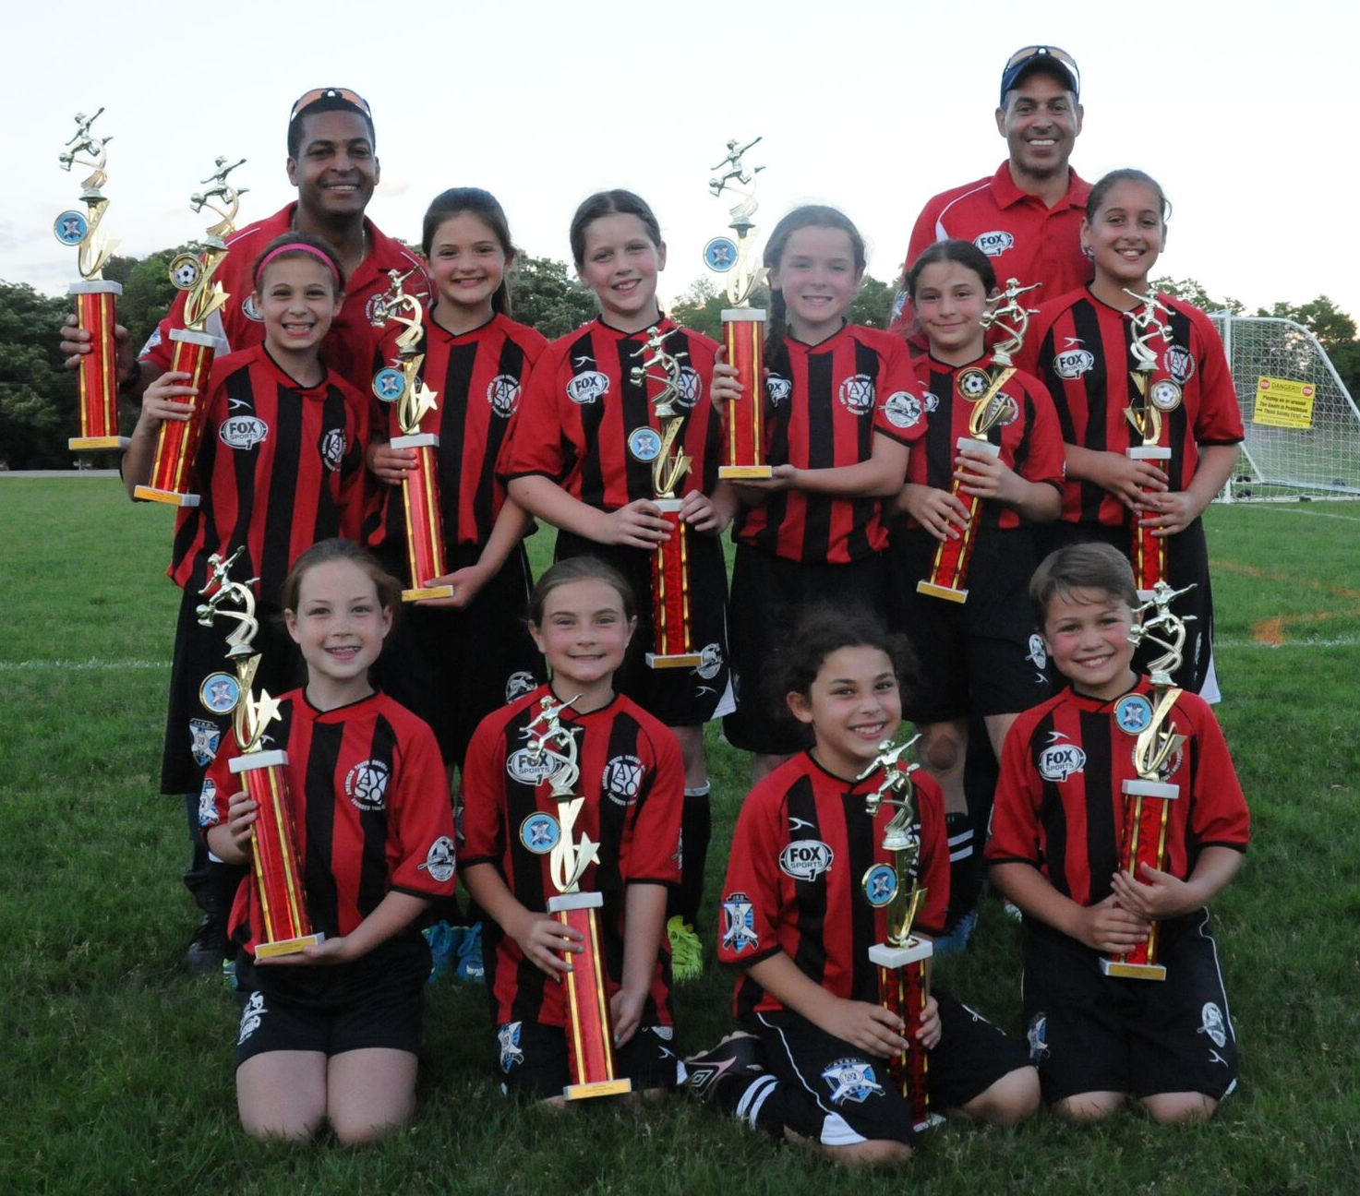
AYSO EXTRA
Boys and Girls team(s) for both the 10U and 12U Divisions
“Higher” level of play for those players who possess the appropriate interest, skills and abilities
Enhances each player’s experience and individual growth while maintaining the spirit of AYSO
Spring tryouts for upcoming fall
Not designed to overshadow or harm the standard primary program
Players selected MUST also register and PLAY on a primary team
Team practices should be coordinated so they don’t overlap

Slide 10
Coach Administrator
Brad Sloan
RCA@DeerfieldAYSO.org

Slide 11
Training Required
aysou.org > Online Courses
AYSO’s Safe Haven
CDC HEADS UP Concussion Training
New: Sudden Cardiac Arrest (Recommended)
Age Appropriate Coach Training
Live coaching courses offered at Jewett Park Community Center
5U/6U/8U: Sunday 8/28 from 10:00a-12:00p
10U/12U: Sunday 8/29 from 10:30a-2:30p

Slide 12
General Information
Advanced Game Cancellations by Commissioner ONLY
Thor Guard, lightning & thunder at site by coach/referee
Park legally, respect property

Slide 13
Team Practices
Plan Practices IN ADVANCE
Be realistic & patient
Check field
Each child should have ball, water & shin guards
Keep drills short
The GAME Teaches
DO NOT LEAVE KIDS
Pick-up/drop-off Procedures
Cancel for Thor Guard, thunder, lightning

Slide 14
Game Day
Have line-up card done ahead of time
Uniforms & Shin Guards Must be worn
Stay in designated areas
Blood – Stop/clean/cover

Slide 15
Game Day
Keep players together
Have a game plan
If one team is short players, share & rotate shared players
Cheer ALL good plays
GAME IS FOR KIDS / Training Session is for coach
No team snacks until further notice
Rain, Snow - We Play

Slide 16
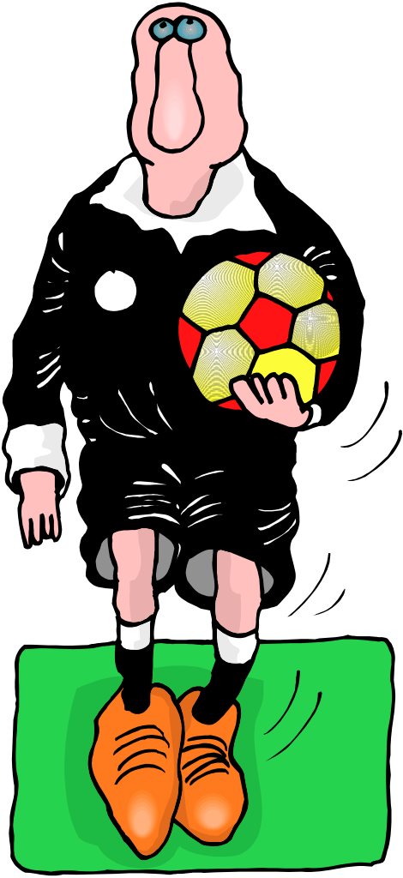
Regional Referee Administrator
Tomer Amram
RRA@DeerfieldAYSO.org

Slide 17
Referee Training
Online content
aysou.org > Online Courses > AYSO's Summary of the Laws of the Game

Slide 18
Important Rule Reminders
Heading the ball is NOT allowed 12U and below (restart play w/IFK)
Goalkeeper punts/drop kicks are NOT allowed 10U and below
10U matches include build-out lines. More information provided during 10U coach training.
Training video: https://ayso1ref.com/mp4/BOL-2019-v31.mp4

Slide 19
During all games only one volunteer (P2 trainer for 5U) on the field acting as a referee, all other coaches must be on the sidelines
Any issues or questions concerning the Laws of the Game administered during game day can be emailed to RRA@DeerfieldAYSO.org

Slide 20
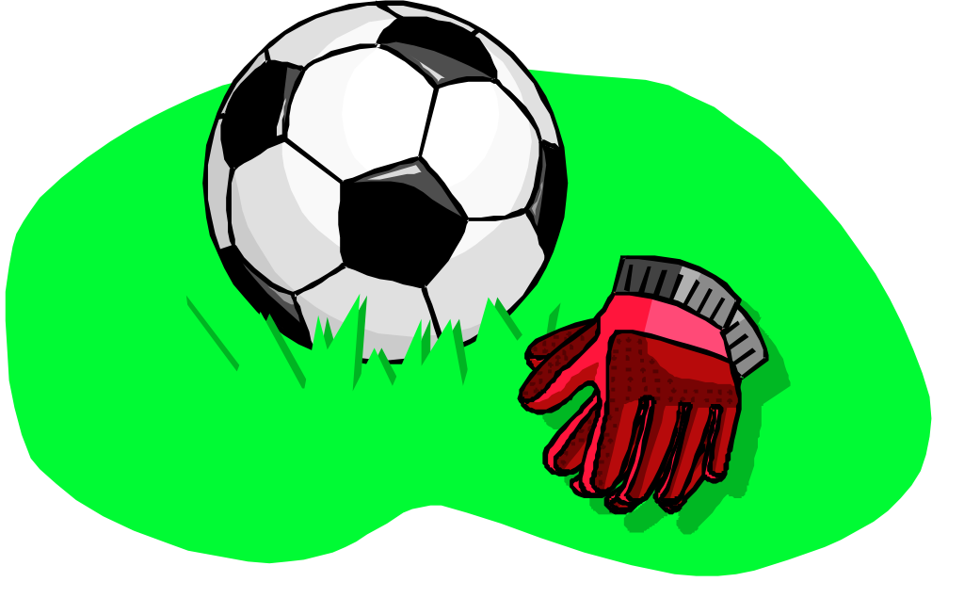
Equipment Director
Steve Harfield
Equipment@DeerfieldAYSO.org

Slide 21
Team Box
Multiple size uniforms
Pinnies
Coach shirts (2)
Coach bag
Equipment
You will receive email with info on team box pick up from division manager or board member
(No shed hours)

Slide 22
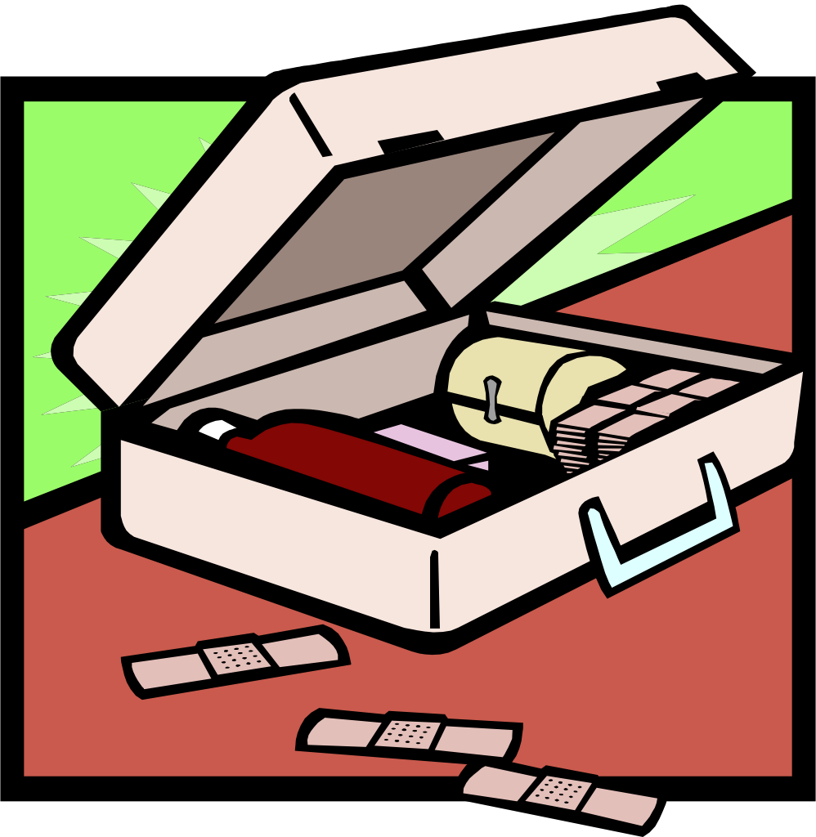
Safety Director
Drew Serlin
Safety@DeerfieldAYSO.org
847-530-8568

Slide 23
Safety First
Illinois Sports Safety Guidance | IDPH (illinois.gov)
Always check fields for safety
Thor Guard – Lightning Prediction System
No Jewelry – PERIOD, even string bracelets
No Pets

Slide 24
Injuries
Incident report must be completed by coach and sent to Safety@deerfieldayso.org, if injury occurs during game or practice that requires medical attention
Incident form can be found at www.ayso.org
Players with a hard cast or brace, even with doctor's clearance, MAY NOT PARTICIPATE IN TRAINING OR GAMES

Slide 25
Child and Volunteer Protection Advocate
Drew Serlin
CVPA@DeerfieldAYSO.org
847-530-8568

Slide 26
Certificate Verification
Background Checks
Coach Certification requirements
2 Adults MANDATORY
NO unregistered adults or kids on field

Slide 27
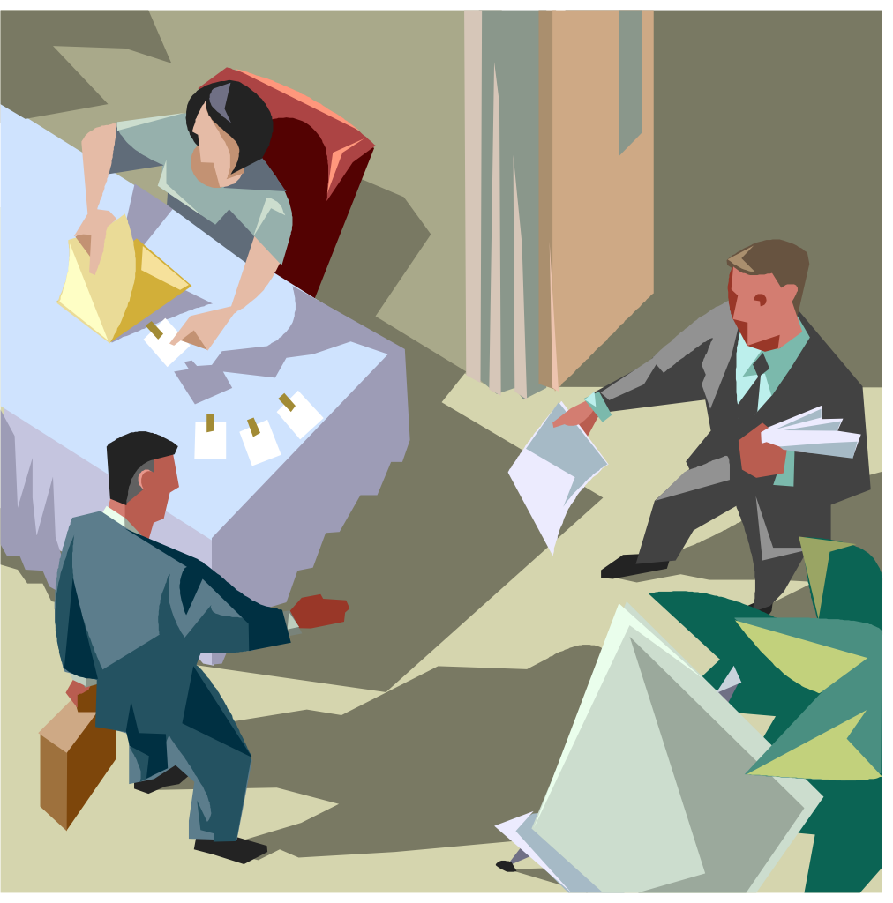
Registrar
Eric Meyers
Registrar@DeerfieldAYSO.org

Slide 28
What to Do Next!
Review draft rosters and confirm Name, Age, Grade & Gender
Inform Division Managers immediately if there are any issues
Final rosters will be distributed on Monday 8/30
Email parents after you receive final rosters
Pick up uniform package (Division Managers to provide details)
Set up team meeting to distribute uniforms
Schedule practices
Regularly Check website for Schedules/Changes
Games start September 12th

Slide 29
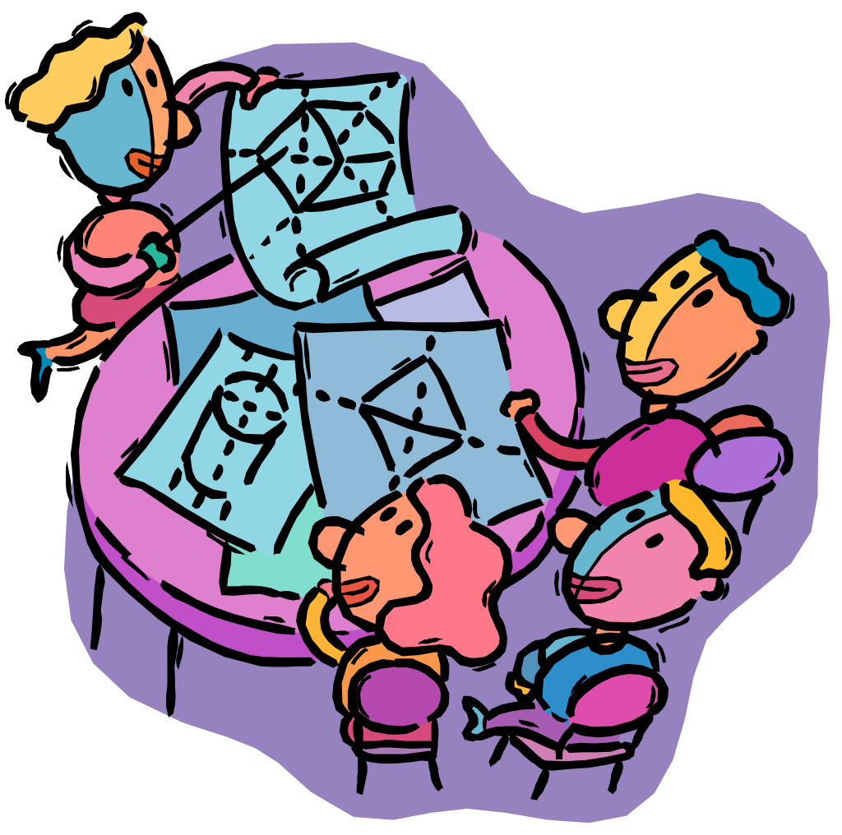
At Team Meeting
Select team parent
Arrange extra parent to stay
Select team name
Policies, procedures, safety, rules
Review AYSO Philosophies
Distribute uniforms

Slide 30
Division Managers Contact email on web site http://www.deerfieldayso.org/
Division | Contact
Playground | Daniel Moons
5U | Eric Meyers
6U | Brad Zabel
8U | Mike Collins
10U | Brad Sloan
12U/14U | Ron Schwartz
EXTRA | Bobby Cooper

Slide 31
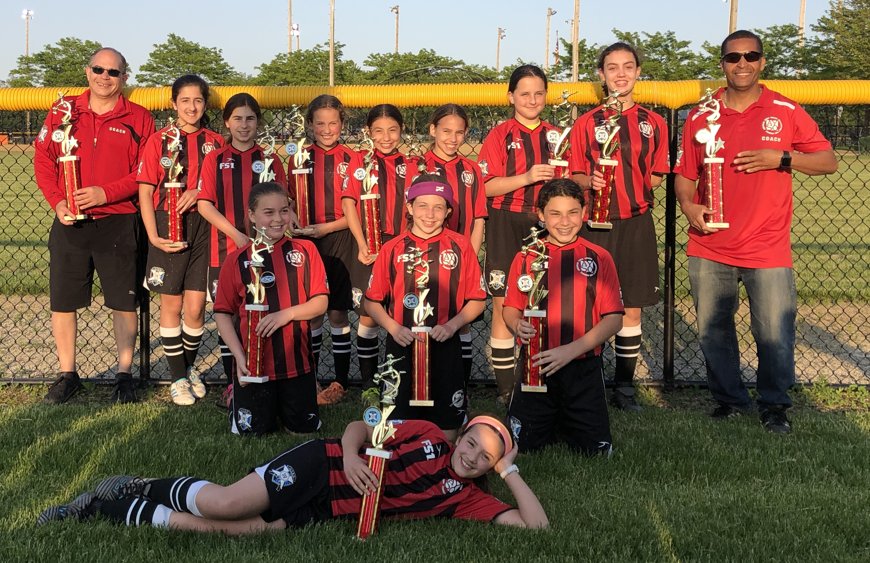
Play Soccer - First Game September 12th

